Slide 1
Advanced Encryption Standard
This lecture is mainly based on the power point slides by Professor Lawrie Brown.
Notes:
Zili Shao

Slide 2
Origins
A replacement for DES was needed
  have theoretical attacks that can break it
  have demonstrated exhaustive key search attacks
An alternative: Triple-DES
  but slow with small blocks
US NIST issued call for ciphers in 1997
15 candidates accepted in Jun 98
5 were shortlisted in Aug-99
Rijndael was selected as the AES in Oct-2000
issued as FIPS PUB 197 standard in Nov-2001
CEG 260, Meilin Liu
Notes:
Zili Shao
The AES candidates are the latest generation of block ciphers, and now we see a significant increase in the block size - from the old standard of 64-bits up to 128-bits; and keys from 128 to 256-bits. In part this has been driven by the public demonstrations of exhaustive key searches of DES. Whilst triple-DES is regarded as secure and well understood, it is slow, especially in s/w.

Slide 3
AES Requirements
Private key symmetric block cipher
128-bit data, 128/192/256-bit keys
Stronger & faster than Triple-DES
Active life of 20-30 years (+ archival use)
Provide full specification & design details
Both C & Java implementations
NIST have released all submissions & unclassified analyses
CEG 260, Meilin Liu

Slide 4
AES Evaluation Criteria
Initial criteria:
  Security vs effort to practical cryptanalysis
  Cost – computational
  Algorithm & implementation characteristics
Final criteria
  General security
  Software & hardware implementation ease
  Defend against timing and power attacks
  Flexibility (in en/decrypt, keying, other factors)
CEG 260, Meilin Liu
Notes:
Zili Shao
Initial criteria were issued with call, and used to evaluate field of 15 candidates to select shortlist of 5.
The final criteria were used to select Rijndael from that short-list.

Slide 5
AES Shortlist
After testing and evaluation, shortlist in Aug-99:
  MARS (IBM) - complex, fast, high security margin
  RC6 (USA) - v. simple, v. fast, low security margin
  Rijndael (Belgium) - clean, fast, good security margin
  Serpent (Euro) - slow, clean, v. high security margin
  Twofish (USA) - complex, v. fast, high security margin
Then subject to further analysis & comment
Contrast between algorithms with
  few complex rounds verses many simple rounds
  which refined existing ciphers verses new proposals
CEG 260, Meilin Liu
Notes:
Zili Shao
The AES shortlist of 5 ciphers was as shown. Note mix of commercial (MARS, RC6, Twofish) verses academic (Rijndael, Serpent) proposals, sourced from various countries.
All were thought to be good – it came down to the best balance of attributes to meet criteria, in particular the balance between speed, security & flexibility.

Slide 6
The AES Cipher - Rijndael
Belgian designers: Joan Daemen & Vincent Rijmen
Has 128/192/256 bit keys, 128 bit data
An iterative rather than feistel cipher
  processes data as block of 4 columns of 4 bytes
  operates on entire data block in every round
Designed to be:
  resistant against known attacks
  speed and code compactness on many CPUs
  design simplicity
CEG 260, Meilin Liu
Notes:
Zili Shao
The Rijndael proposal for AES defined a cipher in which the block length and the key length can be independently specified to be 128,192,or 256 bits. The AES specification uses the same three key size alternatives but limits the block length to 128 bits. Rijndael is an academic submission, based on the earlier Square cipher, from Belgium academics Dr Joan Daemen and Dr Vincent Rijmen. It is an iterative cipher (operates on entire data block in every round) rather than feistel (operate on halves at a time), and was designed to have characteristics of: Resistance against all known attacks, Speed and code compactness on a wide range of platforms, & Design simplicity.

Slide 7
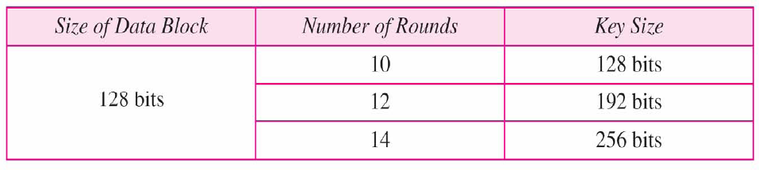
Advanced Encryption Standard
Also called Rijndael Algorithm
128 bit blocks, keys:-128, 192,256 bits long
NIST (National Institute of Standards and Technology) estimates that a machine that could crack 56-bit DES in one second (2^55 keys per second) would take approx. 149 trillion years to crack a 128-bit AES key.
CEG 260, Meilin Liu
Notes:
Zili Shao
All security policies and mechanisms rest on assumptions; we’ll examine some in later chapters, most notably Chapter 22, Malicious Logic. Here is a taste of the assumptions.
Policies: as these define security, they have to define security correctly for the particular site. For example, a web site has to be available, but if the security policy does not mention availability, the definition of security is inappropriate for the site. Also, a policy may not specify whether a particular state is “secure” or “non-secure.” This ambiguity causes problems.
Mechanisms: as these enforce policy, they must be appropriate. For example, cryptography does not assure availability, so using cryptography in the above situation won’t work. Further, security mechanisms rely on supporting infrastructure, such as compilers, libraries, the hardware, and networks to work correctly. Ken Thompson’s modified C preprocessor (see the example on p. 615) illustrates this point very well.

Slide 8
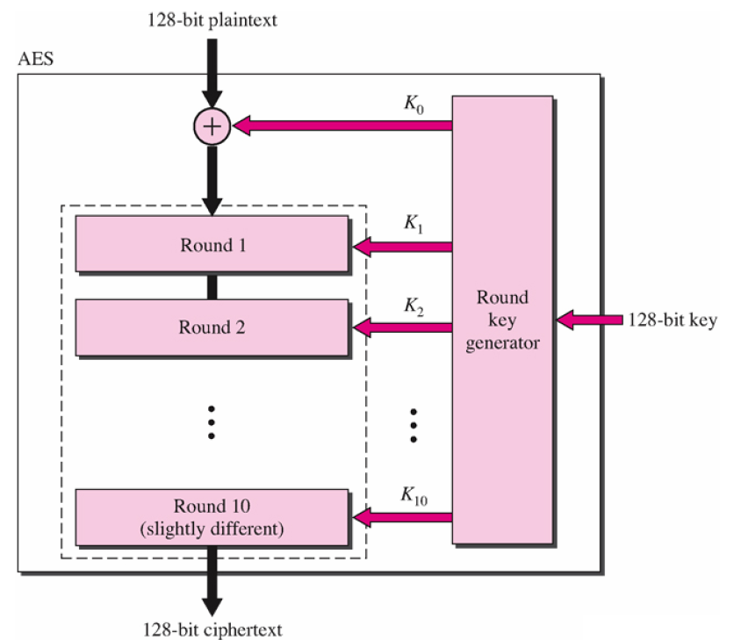
Advanced Encryption Standard
CEG 260, Meilin Liu
Notes:
Zili Shao
All security policies and mechanisms rest on assumptions; we’ll examine some in later chapters, most notably Chapter 22, Malicious Logic. Here is a taste of the assumptions.
Policies: as these define security, they have to define security correctly for the particular site. For example, a web site has to be available, but if the security policy does not mention availability, the definition of security is inappropriate for the site. Also, a policy may not specify whether a particular state is “secure” or “non-secure.” This ambiguity causes problems.
Mechanisms: as these enforce policy, they must be appropriate. For example, cryptography does not assure availability, so using cryptography in the above situation won’t work. Further, security mechanisms rely on supporting infrastructure, such as compilers, libraries, the hardware, and networks to work correctly. Ken Thompson’s modified C preprocessor (see the example on p. 615) illustrates this point very well.

Slide 9
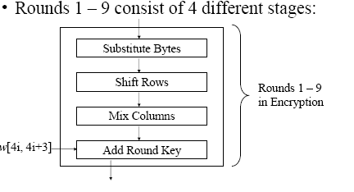
Advanced Encryption Standard
CEG 260, Meilin Liu
Notes:
Zili Shao
All security policies and mechanisms rest on assumptions; we’ll examine some in later chapters, most notably Chapter 22, Malicious Logic. Here is a taste of the assumptions.
Policies: as these define security, they have to define security correctly for the particular site. For example, a web site has to be available, but if the security policy does not mention availability, the definition of security is inappropriate for the site. Also, a policy may not specify whether a particular state is “secure” or “non-secure.” This ambiguity causes problems.
Mechanisms: as these enforce policy, they must be appropriate. For example, cryptography does not assure availability, so using cryptography in the above situation won’t work. Further, security mechanisms rely on supporting infrastructure, such as compilers, libraries, the hardware, and networks to work correctly. Ken Thompson’s modified C preprocessor (see the example on p. 615) illustrates this point very well.

Slide 10
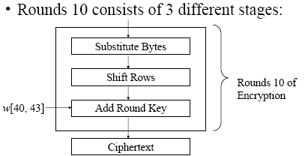
Advanced Encryption Standard
CEG 260, Meilin Liu
Notes:
Zili Shao
All security policies and mechanisms rest on assumptions; we’ll examine some in later chapters, most notably Chapter 22, Malicious Logic. Here is a taste of the assumptions.
Policies: as these define security, they have to define security correctly for the particular site. For example, a web site has to be available, but if the security policy does not mention availability, the definition of security is inappropriate for the site. Also, a policy may not specify whether a particular state is “secure” or “non-secure.” This ambiguity causes problems.
Mechanisms: as these enforce policy, they must be appropriate. For example, cryptography does not assure availability, so using cryptography in the above situation won’t work. Further, security mechanisms rely on supporting infrastructure, such as compilers, libraries, the hardware, and networks to work correctly. Ken Thompson’s modified C preprocessor (see the example on p. 615) illustrates this point very well.

Slide 11
Advanced Encryption Standard
The 4 stages used in the rounds consist of three substitutions and one permutation
  Substitution Bytes (Substitution)
    S – Boxes in byte to byte substitution of block
  Shift Rows (Simple Permutation)
  Mix Columns (Substitution)
    Uses Finite field arithmetic on GF(2^8)
  Add Round Key (Substitution)
    Simple bitwise XOR of current block with portion of expanded key
    This is the only stage that uses the key
CEG 260, Meilin Liu
Notes:
Zili Shao
All security policies and mechanisms rest on assumptions; we’ll examine some in later chapters, most notably Chapter 22, Malicious Logic. Here is a taste of the assumptions.
Policies: as these define security, they have to define security correctly for the particular site. For example, a web site has to be available, but if the security policy does not mention availability, the definition of security is inappropriate for the site. Also, a policy may not specify whether a particular state is “secure” or “non-secure.” This ambiguity causes problems.
Mechanisms: as these enforce policy, they must be appropriate. For example, cryptography does not assure availability, so using cryptography in the above situation won’t work. Further, security mechanisms rely on supporting infrastructure, such as compilers, libraries, the hardware, and networks to work correctly. Ken Thompson’s modified C preprocessor (see the example on p. 615) illustrates this point very well.

Slide 12
Advanced Encryption Standard
Decryption makes use of keys in reverse order – just as with DES
Decryption algorithm is not the same as the Encryption algorithm – unlike DES
The 4 stages used in the rounds consist of three substitutions and one permutation
  Inverse Shift Rows (Simple Permutation)
  Inverse Substitution Bytes (Substitution)
  Add Round Key (Substitution)
  Inverse Mix Columns (Substitution)
10th round involves 3 stages as in encryption
CEG 260, Meilin Liu
Notes:
Zili Shao
All security policies and mechanisms rest on assumptions; we’ll examine some in later chapters, most notably Chapter 22, Malicious Logic. Here is a taste of the assumptions.
Policies: as these define security, they have to define security correctly for the particular site. For example, a web site has to be available, but if the security policy does not mention availability, the definition of security is inappropriate for the site. Also, a policy may not specify whether a particular state is “secure” or “non-secure.” This ambiguity causes problems.
Mechanisms: as these enforce policy, they must be appropriate. For example, cryptography does not assure availability, so using cryptography in the above situation won’t work. Further, security mechanisms rely on supporting infrastructure, such as compilers, libraries, the hardware, and networks to work correctly. Ken Thompson’s modified C preprocessor (see the example on p. 615) illustrates this point very well.

Slide 13

Rijndael
CEG 260, Meilin Liu
Notes:
Zili Shao
Stallings Figure 5.1 shows the overall structure of AES, as detailed on the previous slide.

Slide 14
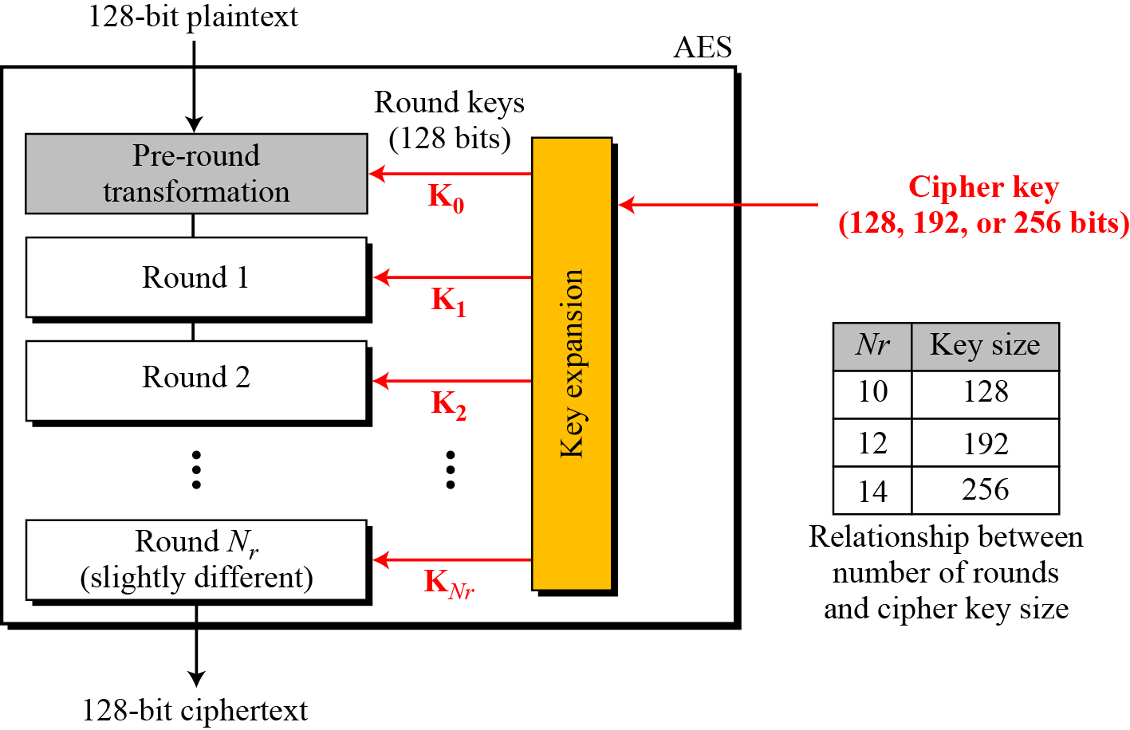
Advanced Encryption Standard
CEG 260, Meilin Liu
Notes:
Zili Shao
All security policies and mechanisms rest on assumptions; we’ll examine some in later chapters, most notably Chapter 22, Malicious Logic. Here is a taste of the assumptions.
Policies: as these define security, they have to define security correctly for the particular site. For example, a web site has to be available, but if the security policy does not mention availability, the definition of security is inappropriate for the site. Also, a policy may not specify whether a particular state is “secure” or “non-secure.” This ambiguity causes problems.
Mechanisms: as these enforce policy, they must be appropriate. For example, cryptography does not assure availability, so using cryptography in the above situation won’t work. Further, security mechanisms rely on supporting infrastructure, such as compilers, libraries, the hardware, and networks to work correctly. Ken Thompson’s modified C preprocessor (see the example on p. 615) illustrates this point very well.

Slide 15
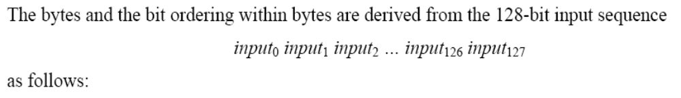
AES: Data Units Used in AES
CEG 260, Meilin Liu
Notes:
Zili Shao
All security policies and mechanisms rest on assumptions; we’ll examine some in later chapters, most notably Chapter 22, Malicious Logic. Here is a taste of the assumptions.
Policies: as these define security, they have to define security correctly for the particular site. For example, a web site has to be available, but if the security policy does not mention availability, the definition of security is inappropriate for the site. Also, a policy may not specify whether a particular state is “secure” or “non-secure.” This ambiguity causes problems.
Mechanisms: as these enforce policy, they must be appropriate. For example, cryptography does not assure availability, so using cryptography in the above situation won’t work. Further, security mechanisms rely on supporting infrastructure, such as compilers, libraries, the hardware, and networks to work correctly. Ken Thompson’s modified C preprocessor (see the example on p. 615) illustrates this point very well.

Slide 16
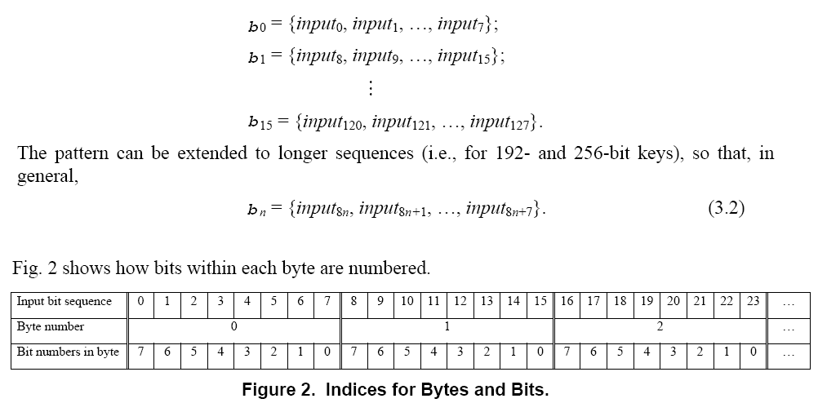
AES: Data Units Used in AES
CEG 260, Meilin Liu
Notes:
Zili Shao
All security policies and mechanisms rest on assumptions; we’ll examine some in later chapters, most notably Chapter 22, Malicious Logic. Here is a taste of the assumptions.
Policies: as these define security, they have to define security correctly for the particular site. For example, a web site has to be available, but if the security policy does not mention availability, the definition of security is inappropriate for the site. Also, a policy may not specify whether a particular state is “secure” or “non-secure.” This ambiguity causes problems.
Mechanisms: as these enforce policy, they must be appropriate. For example, cryptography does not assure availability, so using cryptography in the above situation won’t work. Further, security mechanisms rely on supporting infrastructure, such as compilers, libraries, the hardware, and networks to work correctly. Ken Thompson’s modified C preprocessor (see the example on p. 615) illustrates this point very well.

Slide 17
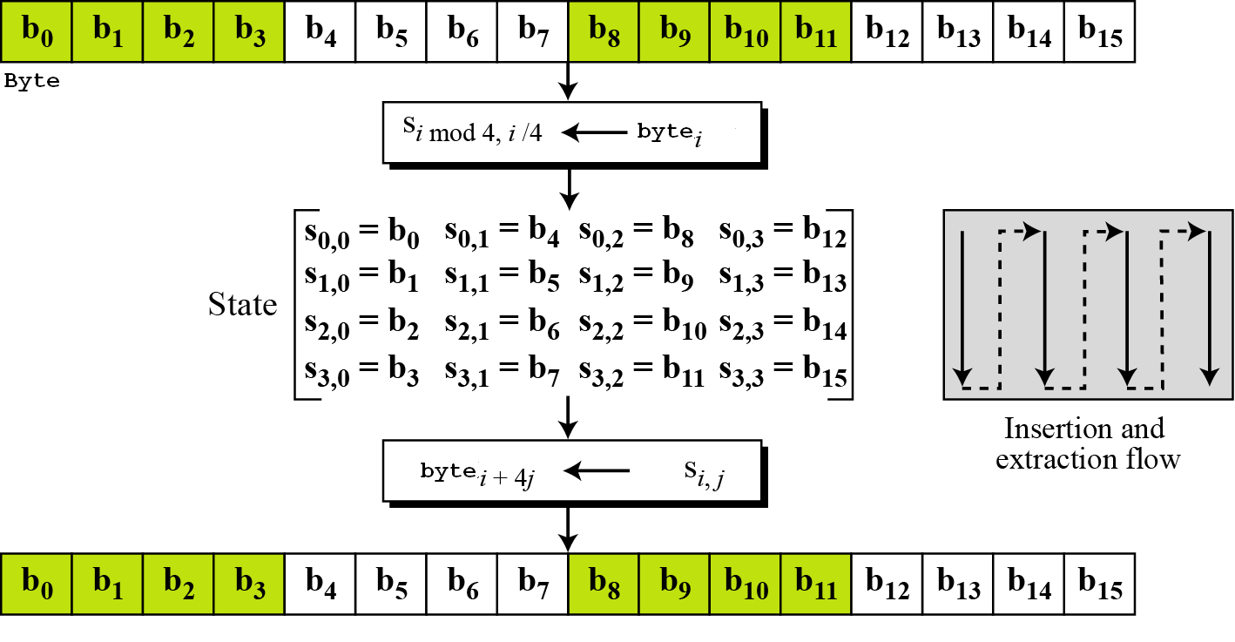
AES:Block-to-state and state-to-block transformation
CEG 260, Meilin Liu
Notes:
Zili Shao
All security policies and mechanisms rest on assumptions; we’ll examine some in later chapters, most notably Chapter 22, Malicious Logic. Here is a taste of the assumptions.
Policies: as these define security, they have to define security correctly for the particular site. For example, a web site has to be available, but if the security policy does not mention availability, the definition of security is inappropriate for the site. Also, a policy may not specify whether a particular state is “secure” or “non-secure.” This ambiguity causes problems.
Mechanisms: as these enforce policy, they must be appropriate. For example, cryptography does not assure availability, so using cryptography in the above situation won’t work. Further, security mechanisms rely on supporting infrastructure, such as compilers, libraries, the hardware, and networks to work correctly. Ken Thompson’s modified C preprocessor (see the example on p. 615) illustrates this point very well.

Slide 18
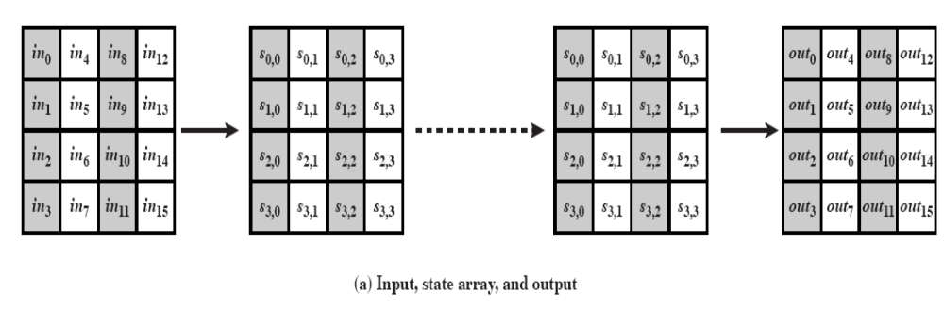
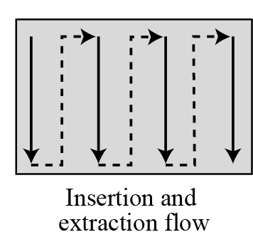
AES:Block-to-state and state-to-block transformation
CEG 260, Meilin Liu
Notes:
Zili Shao
All security policies and mechanisms rest on assumptions; we’ll examine some in later chapters, most notably Chapter 22, Malicious Logic. Here is a taste of the assumptions.
Policies: as these define security, they have to define security correctly for the particular site. For example, a web site has to be available, but if the security policy does not mention availability, the definition of security is inappropriate for the site. Also, a policy may not specify whether a particular state is “secure” or “non-secure.” This ambiguity causes problems.
Mechanisms: as these enforce policy, they must be appropriate. For example, cryptography does not assure availability, so using cryptography in the above situation won’t work. Further, security mechanisms rely on supporting infrastructure, such as compilers, libraries, the hardware, and networks to work correctly. Ken Thompson’s modified C preprocessor (see the example on p. 615) illustrates this point very well.

Slide 19
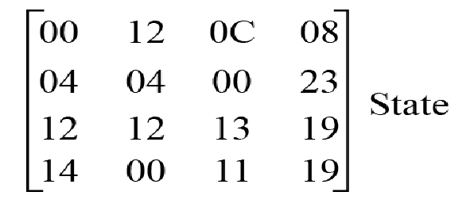
AES: Changing plaintext to state (initial state)
Hexidecimal: 00 04 12 14 12 04 12 00 0C 00 13 11 08 23 19 19
CEG 260, Meilin Liu
Notes:
Zili Shao
All security policies and mechanisms rest on assumptions; we’ll examine some in later chapters, most notably Chapter 22, Malicious Logic. Here is a taste of the assumptions.
Policies: as these define security, they have to define security correctly for the particular site. For example, a web site has to be available, but if the security policy does not mention availability, the definition of security is inappropriate for the site. Also, a policy may not specify whether a particular state is “secure” or “non-secure.” This ambiguity causes problems.
Mechanisms: as these enforce policy, they must be appropriate. For example, cryptography does not assure availability, so using cryptography in the above situation won’t work. Further, security mechanisms rely on supporting infrastructure, such as compilers, libraries, the hardware, and networks to work correctly. Ken Thompson’s modified C preprocessor (see the example on p. 615) illustrates this point very well.

Slide 20
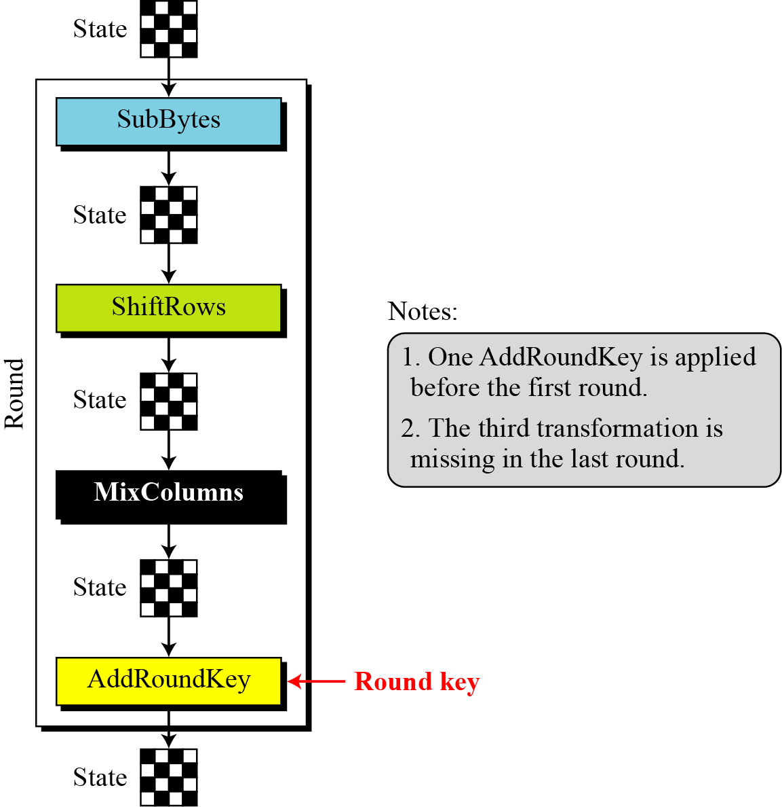
AES: Structure of each round at the encryption site
CEG 260, Meilin Liu
Notes:
Zili Shao
All security policies and mechanisms rest on assumptions; we’ll examine some in later chapters, most notably Chapter 22, Malicious Logic. Here is a taste of the assumptions.
Policies: as these define security, they have to define security correctly for the particular site. For example, a web site has to be available, but if the security policy does not mention availability, the definition of security is inappropriate for the site. Also, a policy may not specify whether a particular state is “secure” or “non-secure.” This ambiguity causes problems.
Mechanisms: as these enforce policy, they must be appropriate. For example, cryptography does not assure availability, so using cryptography in the above situation won’t work. Further, security mechanisms rely on supporting infrastructure, such as compilers, libraries, the hardware, and networks to work correctly. Ken Thompson’s modified C preprocessor (see the example on p. 615) illustrates this point very well.

Slide 21
AES Transformations
AES uses four types of transformations:
  Substitution
  Permutation
  Mixing
  Key-adding
CEG 260, Meilin Liu
Notes:
Zili Shao

Slide 22
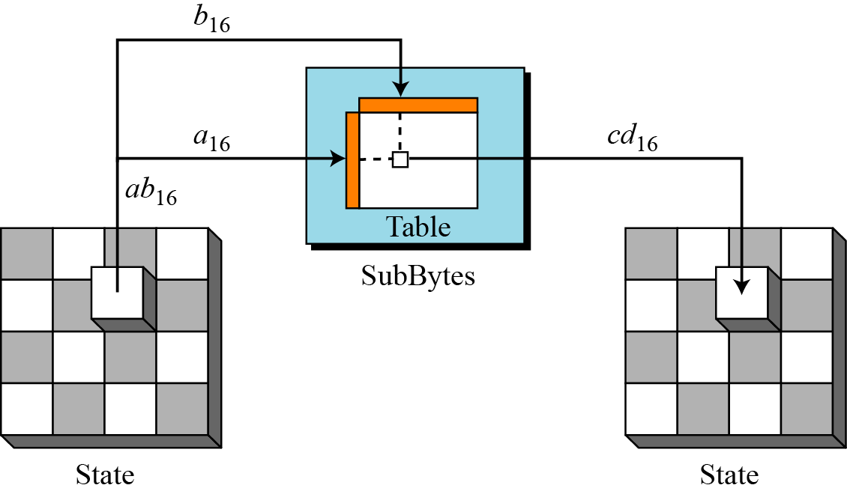
AES Transformations
Substitutions
  AES uses two invertible substitutions
  SubBytes: substitute byte-by-byte; 16 independent byte-to-byte transformations
CEG 260, Meilin Liu
Notes:
Zili Shao

Slide 23
Byte Substitution
A simple substitution of each byte
uses one table of 16x16 bytes containing a permutation of all 256 8-bit values
each byte of state is replaced by a byte in row (left 4-bits) & column (right 4-bits) independently
  eg. byte {95} is replaced by row 9 col 5 byte
  which is the value {2A}
S-box is constructed using a defined transformation of the values in GF(2⁸)
designed to be resistant to all known attacks
CEG 260, Meilin Liu
Notes:
Zili Shao
There is a single 8-bit wide S-box used on every byte. This S-box is a permutation of all 256 8-bit values, constructed using a transformation which treats the values as polynomials in GF(2⁸) – however it is fixed, so really only need to know the table when implementing. Decryption requires the inverse of the table.

Slide 24
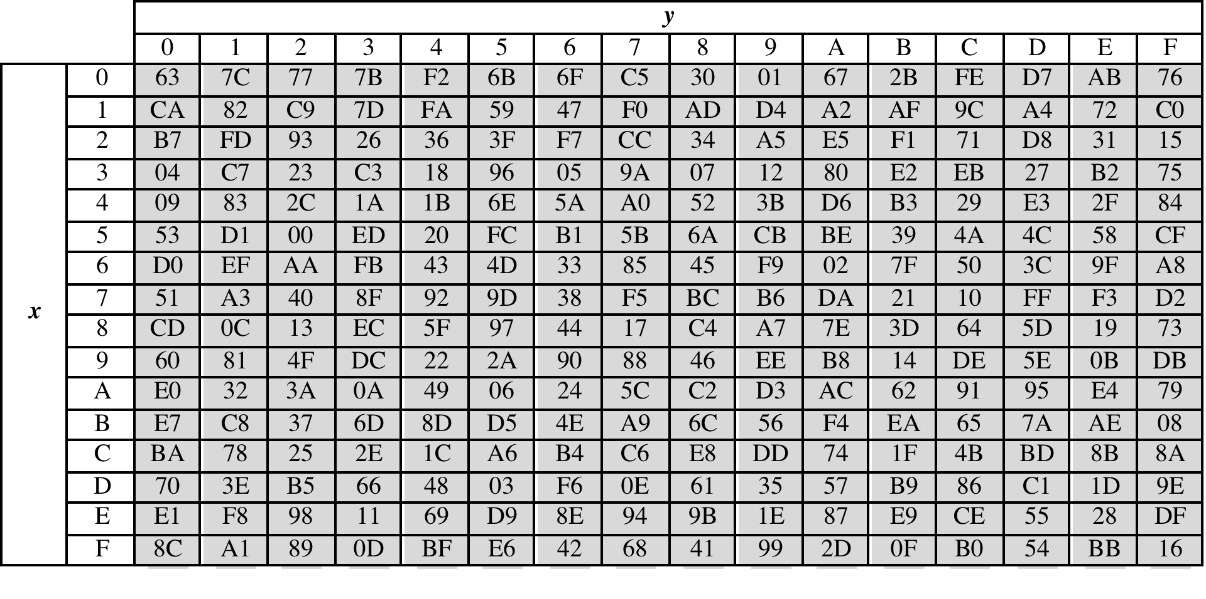
AES Transformations
Substitutions
  SubBytes transformation table
CEG 260, Meilin Liu
Notes:
Zili Shao

Slide 25
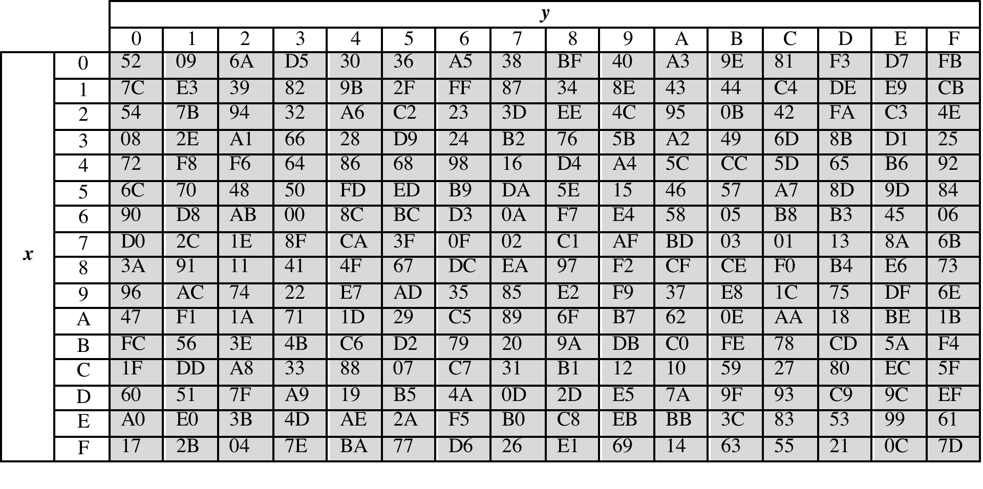
AES Transformations
Substitutions
  InvSubBytes transformation table
CEG 260, Meilin Liu
Notes:
Zili Shao

Slide 26
Construct Byte Substitution-Box
Initialize the S-box with the byte values in ascending sequence row by row. The first row contains {00},{01},{02},…{0F}; the second row contains {10},{11}, etc. Thus, the value of the byte at row x, column y is {xy}
Map each byte in the S-box to its multiplicative inverse in the finite field GF(2⁸).
  As a special case, `00’ is mapped onto itself.
  Note: the inverse is derived from multiplication of corresponding polynomials mod M(x)=x⁸+x⁴+x³+x+1
After that, apply an affine (over GF(2)) transformation defined in the next page
CEG 260, Meilin Liu

Slide 27
Affine Transformation - Example
We should have 95H⁻¹=8A
Verification:
    95H=10010101→ x⁷+x⁴+x²+1
    8AH=10001010→ x⁷+x³+x
    95H*8AH → x¹⁴+x¹¹+x⁹+x⁷+x¹⁰+x⁷+x⁵+x³+x⁸+x⁵+x³+x
    M(x)=x^8+x^4+x^3+x+1
    x^6*M(x)=x¹⁴+x¹⁰+x⁹+x⁷+x⁶
    x^3*M(x)=x¹¹+x⁷+x⁶+x⁴+x³
    95H*8AH =(x^6+x^3+1)*M(x)+1
CEG 260, Meilin Liu

Slide 28
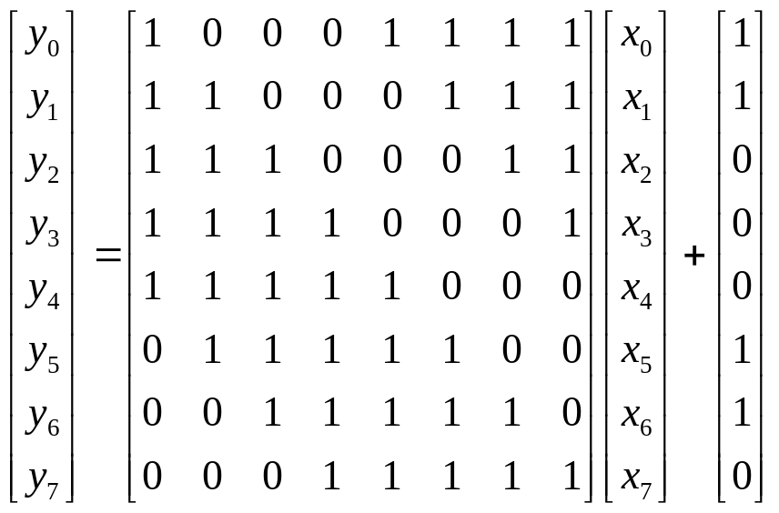
Affine Transformation
Least Significant bit
Least Significant bit
Most Significant bit
Most Significant bit
CEG 260, Meilin Liu

Slide 29
Affine Transformation – Example – Cont.
Least Significant bit
Least Significant bit
Most Significant bit
Most Significant bit
Note that the ByteSub transformation is invertible.
    E.g. 95H⁻¹=8A=10001010,
    y=01001001+01100011=00101010, Sub(95H)=00101010H=2A
CEG 260, Meilin Liu

Slide 30
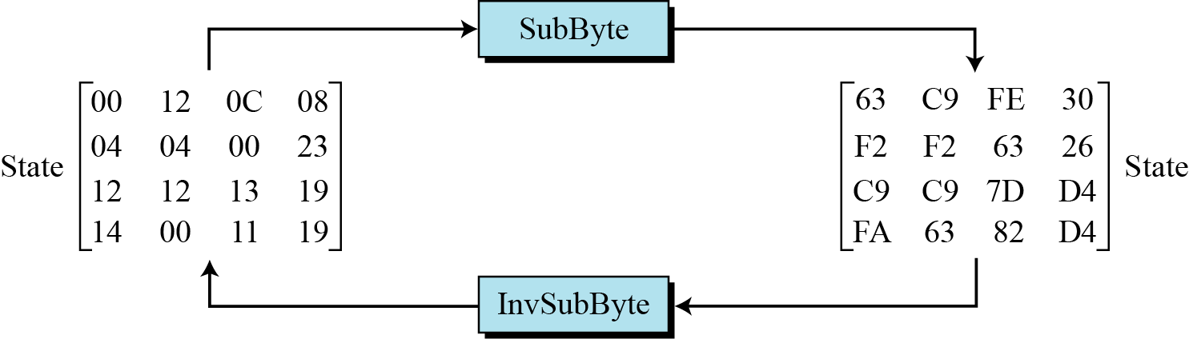
AES Transformations
  SubByte and InvSubByte transformations
CEG 260, Meilin Liu
Notes:
Zili Shao

Slide 31
Shift Rows
ShiftRows transformation permutes bytes
A circular byte shift in the last three rows
  1st row is unchanged
  2nd row does 1 byte circular shift to left
  3rd row does 2 byte circular shift to left
  4th row does 3 byte circular shift to left
Decrypt inverts using shifts to right
Since state is processed by columns, this step permutes bytes between the columns
CEG 260, Meilin Liu
Notes:
Zili Shao
The ShiftRows stage provides a simple “permutation” of the data, whereas the other steps involve substitutions. Further, since the state is treated as a block of columns, it is this step which provides for diffusion of values between columns. It performs a circular rotate on each row of 0, 1, 2 & 3 places for respective rows. When decrypting it performs the circular shifts in the opposite direction for each row. This row shift moves an individual byte from one column to another, which is a linear distance of a multiple of 4 bytes, and ensures that the 4 bytes of one column are spread out to four different columns.

Slide 32

Shift Rows
CEG 260, Meilin Liu
Notes:
Zili Shao
Stalling Figure 5.5a illustrates the Shift Rows permutation.

Slide 33
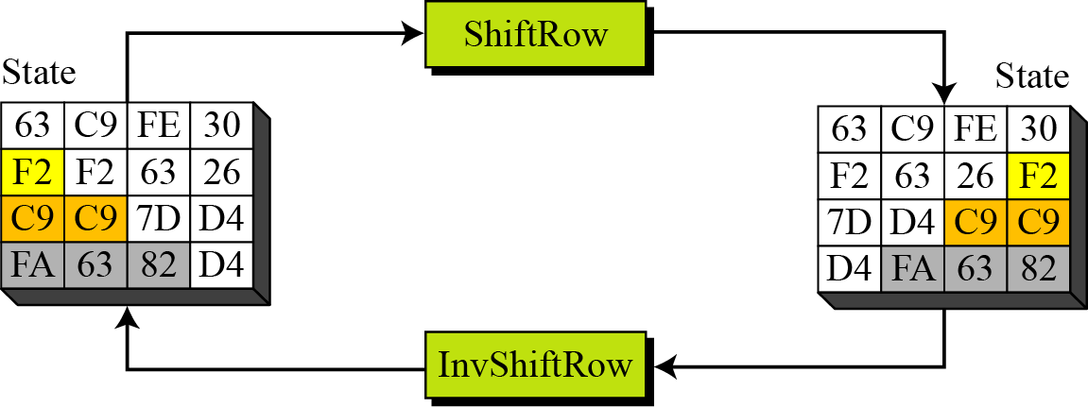
AES Transformations
CEG 260, Meilin Liu
Notes:
Zili Shao

Slide 34
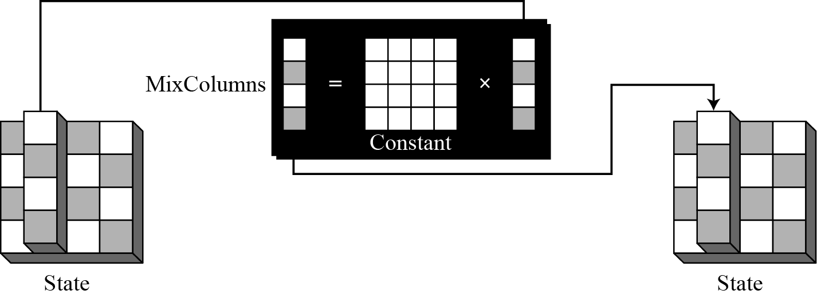
AES Transformations
MixColumns and InvMixColumns transformations
  The MixColumns and InvMixColumns transformation operates at the column level; it transforms each column of the state to a new column
=
x
constant
CEG 260, Meilin Liu
Notes:
Zili Shao

Slide 35

Mix Columns
Each column is processed separately
Each byte is replaced by a value dependent on all 4 bytes in the column
Effectively a matrix multiplication in GF(2⁸) using prime poly m(x) =x⁸+x⁴+x³+x+1
CEG 260, Meilin Liu
Notes:
Zili Shao
The MixColumns stage is a substitution that makes use of arithmetic over GF(2^8). Each byte of a column is mapped into a new value that is a function of all four bytes in that column. It is designed as a matrix multiplication where each byte is treated as a polynomial in GF(2⁸). The inverse used for decryption involves a different set of constants.
The constants used are based on a linear code with maximal distance between code words – this gives good mixing of the bytes within each column. Combined with the “shift rows” step provides good avalanche, so that within a few rounds, all output bits depend on all input bits.

Slide 36

Mix Columns
CEG 260, Meilin Liu
Notes:
Zili Shao
Stalling Figure 5.5b illustrates the Mix Columns transformation.

Slide 37
Mix Columns
Express each column as 4 equations
  to derive each new byte in col
Decryption requires use of inverse matrix
  with larger coefficients, hence a little harder
Have an alternate characterisation
  each column a 4-term polynomial
  with coefficients in GF(2⁸)
  and polynomials multiplied modulo (x⁴+1)
CEG 260, Meilin Liu
Notes:
Zili Shao
In practise, you implement Mix Columns by expressing the transformation on each column as 4 equations (Stallings equation 5.4) to compute the new bytes for that column. This computation only involves shifts, XORs & conditional XORs (for the modulo reduction).
The decryption computation requires the use of the inverse of the matrix, which has larger coefficients, and is thus potentially a little harder & slower to implement.
The designers & the AES standard provide an alternate characterisation of Mix Columns, which treats each column of State to be a four-term polynomial with coefficients in GF(2⁸). Each column is multiplied by a fixed polynomial a(x) given in Stallings eqn 5.7. Whilst this is useful for analysis of the stage, the matrix description is all that’s required for implementation.

Slide 38
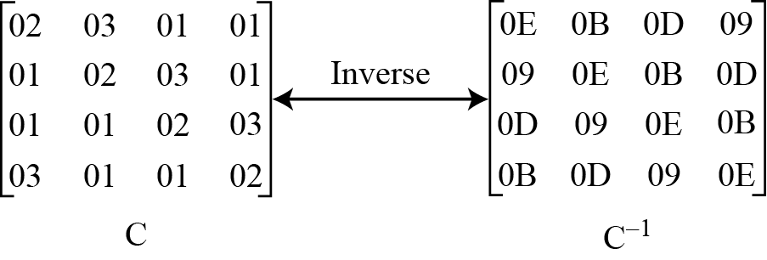
AES Transformations
Mixing transformation
  MixColumns and InvMixColumns operations
  Constant matrices used by MixColumns and InvMixColumns
CEG 260, Meilin Liu
Notes:
Zili Shao

Slide 39
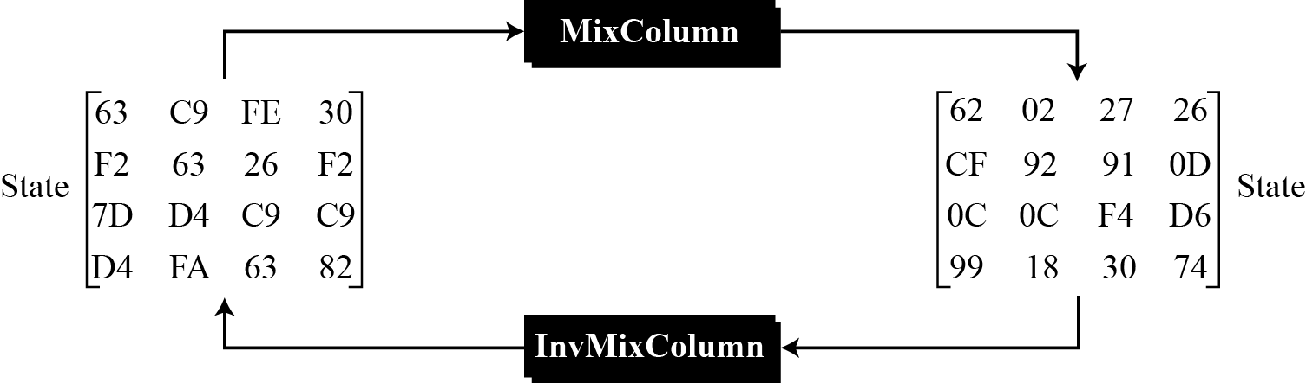
AES Transformations
Example
  MixColumns and InvMixColumns transformations
CEG 260, Meilin Liu
Notes:
Zili Shao

Slide 40
Add Round Key
AddRoundKey transformations
  AddRoundKey proceeds one column at a time
  AddRoundKey adds a round key word with each state column matrix; the operation in AddRoundKey is matrix addition
The AddRoundKey transformation is the inverse of itself.
CEG 260, Meilin Liu
Notes:
Zili Shao

Slide 41
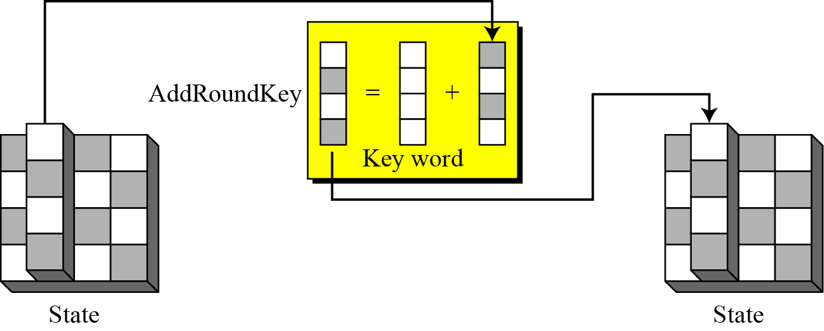
Add Round Key
AddRoundKey transformations
CEG 260, Meilin Liu
Notes:
Zili Shao

Slide 42
Add Round Key
XOR state with 128-bits of the round key
Processed by column (though effectively a series of byte operations)
Inverse for decryption identical
  since XOR own inverse, with reversed keys
Designed to be as simple as possible
  a form of Vernam cipher on expanded key
  requires other stages for complexity / security
CEG 260, Meilin Liu
Notes:
Zili Shao
Lastly is the Add Round Key stage which is a simple bitwise XOR of the current block with a portion of the expanded key. Note this is the only step which makes use of the key and obscures the result, hence MUST be used at start and end of each round, since otherwise could undo effect of other steps. But the other steps provide confusion/diffusion/non-linearity. That us you can look at the cipher as a series of XOR with key then scramble/permute block repeated. This is efficient and highly secure it is believed.

Slide 43

Add Round Key
CEG 260, Meilin Liu
Notes:
Zili Shao
Stallings Figure 5.4b illustrates the Add Round Key stage, which like Byte Substitution, operates on each byte of state independently.

Slide 44
AES Key Expansion
takes 128-bit (16-byte) /192-bit/ 256-bit key and expands into array of 44/52/60 32-bit words
Start by copying key into first 4 words
Then loop creating words that depend on values in previous & 4 places back
  in 3 of 4 cases just XOR these together
  1st word in 4 has rotation + S-box + XOR Round Constant on previous word, before XOR with the key word 4th position back
CEG 260, Meilin Liu
Notes:
Zili Shao
The AES key expansion algorithm takes as input a 4-word (16-byte) key and produces a linear array of words, providing a 4-word round key for the initial AddRoundKey stage and each of the 10/12/14 rounds of the cipher. It involves copying the key into the first group of 4 words, and then constructing subsequent groups of 4 based on the values of the previous & 4th back words. The first word in each group of 4 gets “special treatment” with rotate + S-box + XOR constant on the previous word before XOR’ing the one from 4 back. In the 256-bit key/14 round version, there’s also an extra step on the middle word.

Slide 45
AES Key Expansion
Key Expansion (word key[4], word w[44])
{
word temp
for (i=0;i<4;i++)
w[i]=key[i];
for (i=4;i<44;i++)
{
temp=w[i-1];
if (i mod 4 =0)
temp=SubWord(Rotword(temp)) XOR RCON[i/4];
w[i]=w[i-4] XOR temp;
}
}
CEG 260, Meilin Liu
Notes:
Zili Shao
The AES key expansion algorithm takes as input a 4-word (16-byte) key and produces a linear array of words, providing a 4-word round key for the initial AddRoundKey stage and each of the 10/12/14 rounds of the cipher. It involves copying the key into the first group of 4 words, and then constructing subsequent groups of 4 based on the values of the previous & 4th back words. The first word in each group of 4 gets “special treatment” with rotate + S-box + XOR constant on the previous word before XOR’ing the one from 4 back. In the 256-bit key/14 round version, there’s also an extra step on the middle word.

Slide 46
AES Key Expansion
RotWord performs a one-byte circular left shift on a word
Subword performs a byte substitution on each byte of its input word, using the same S-box as encryption
The first byte of the Round Constant is defined as follows:
The last three bytes of the Round Constant is always 00.
j | 1 | 2 | 3 | 4 | 5 | 6 | 7 | 8 | 9 | 10
Rcon[j] | 01 | 02 | 04 | 08 | 10 | 20 | 40 | 80 | 1B | 36
CEG 260, Meilin Liu
Notes:
Zili Shao
The AES key expansion algorithm takes as input a 4-word (16-byte) key and produces a linear array of words, providing a 4-word round key for the initial AddRoundKey stage and each of the 10/12/14 rounds of the cipher. It involves copying the key into the first group of 4 words, and then constructing subsequent groups of 4 based on the values of the previous & 4th back words. The first word in each group of 4 gets “special treatment” with rotate + S-box + XOR constant on the previous word before XOR’ing the one from 4 back. In the 256-bit key/14 round version, there’s also an extra step on the middle word.

Slide 47
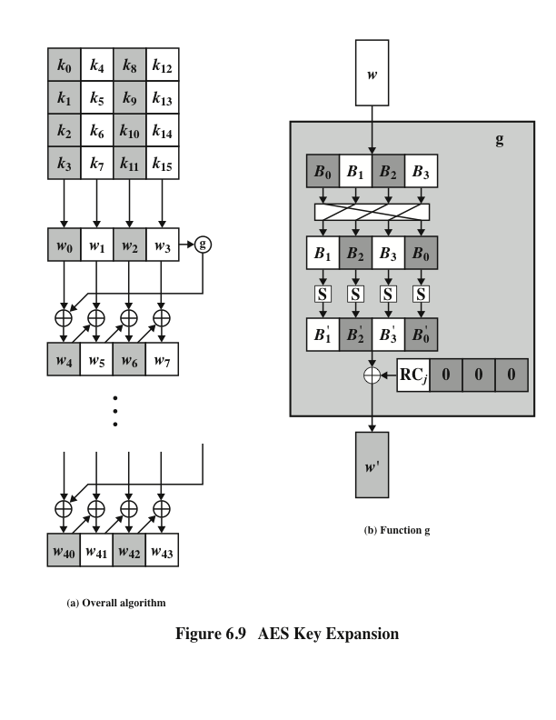
AES Key Expansion
CEG 260, Meilin Liu
Notes:
Zili Shao
The first block of the AES Key Expansion is shown here in Stallings Figure 5.6. It shows each group of 4 bytes in the key being assigned to the first 4 words, then the calculation of the next 4 words based on the values of the previous 4 words, which is repeated enough times to create all the necessary subkey information.

Slide 48
Key Expansion Rationale
Designed to resist known attacks
Design criteria included
  knowing part key insufficient to find many more
  invertible transformation
  fast on wide range of CPU’s
  use round constants to break symmetry
  diffuse key bits into round keys
  enough non-linearity to hinder analysis
  simplicity of description
CEG 260, Meilin Liu
Notes:
Zili Shao
The Rijndael developers designed the expansion key algorithm to be resistant to known cryptanalytic attacks. It is designed to be simple to implement, but by using round constants break symmetries, and make it much harder to deduce other key bits if just some are known (but once have as many consecutive bits as are in key, can then easily recreate the full expansion). The design criteria used are listed above.

Slide 49
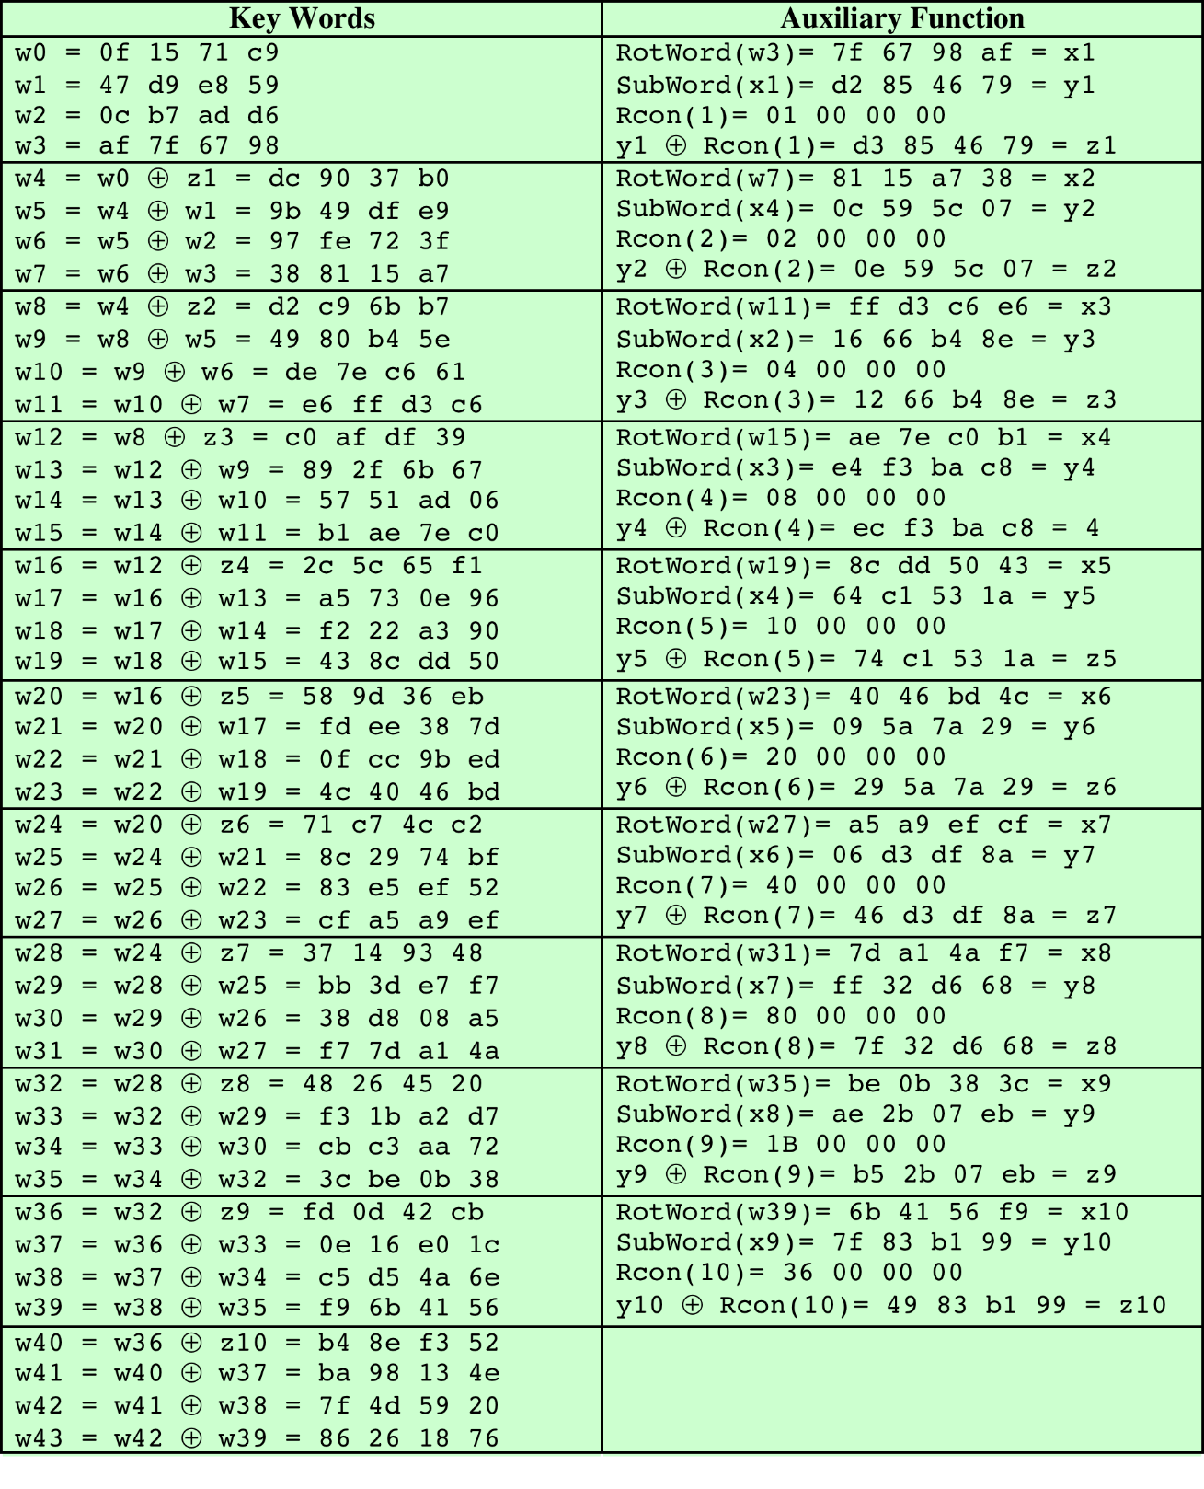
Table 6.4
AES Example Key Expansion
(Table is located on page 168
in textbook)
Notes:
Table 5.3 shows the expansion of the 16-byte key into 10 round keys. As previously
explained, this process is performed word by word, with each four-byte word occupying
one column of the word round-key matrix. The left-hand column shows
the four round-key words generated for each round. The right-hand column shows
the steps used to generate the auxiliary word used in key expansion. We begin, of
course, with the key itself serving as the round key for round 0.

Slide 50
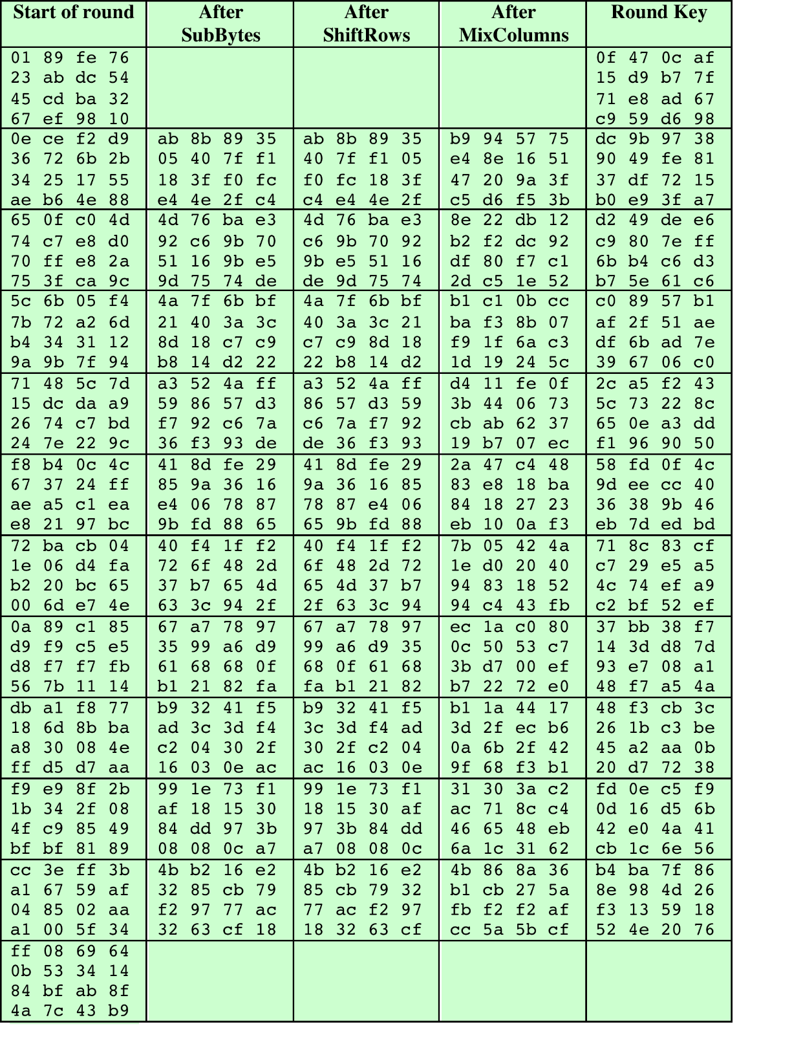

Table 6.5
AES Example
Key: 0f1571c947d9e8590cb7add6af7f6798
(Table is located on page 169
in textbook)
Notes:
Next, Table 5.4 shows the progression of State through the AES encryption
process. The first column shows the value of State at the start of a round. For the
first row, State is just the matrix arrangement of the plaintext. The second, third, and
fourth columns show the value of State for that round after the SubBytes, ShiftRows,
and MixColumns transformations, respectively. The fifth column shows the round
key. You can verify that these round keys equate with those shown in Table 5.3. The
first column shows the value of State resulting from the bitwise XOR of State after
the preceding MixColumns with the round key for the preceding round.

Slide 51
Avalanche Effect
A change of one input or key bit results in changing approximate half output bits
AES exhibits a very strong avalanche effect, stronger than that of DES.
CEG 260, Meilin Liu
Notes:
Zili Shao

Slide 52
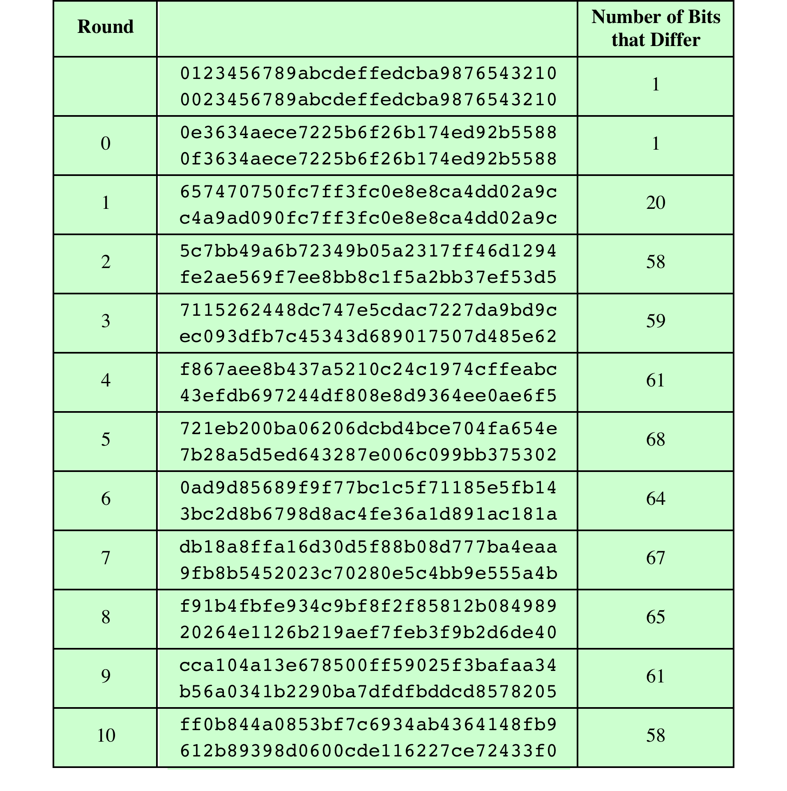
Table 6.6
Avalanche Effect
in AES: Change in Plaintext
Key: 0f1571c947d9e8590cb7add6af7f6798
(Table is located on page 170
in textbook)
Notes:
If a small change in the key or plaintext were to produce a corresponding small
change in the ciphertext, this might be used to effectively reduce the size of the
plaintext (or key) space to be searched. What is desired is the avalanche effect, in
which a small change in plaintext or key produces a large change in the ciphertext.
Using the example from Table 5.4, Table 5.5 shows the result when the
eighth bit of the plaintext is changed. The second column of the table shows the
value of the State matrix at the end of each round for the two plaintexts. Note
that after just one round, 20 bits of the State vector differ. After two rounds,
close to half the bits differ. This magnitude of difference propagates through
the remaining rounds. A bit difference in approximately half the positions in the
most desirable outcome. Clearly, if almost all the bits are changed, this would be
logically equivalent to almost none of the bits being changed. Put another way, if
we select two plaintexts at random, we would expect the two plaintexts to differ
in about half of the bit positions and the two ciphertexts to also differ in about
half the positions.

Slide 53
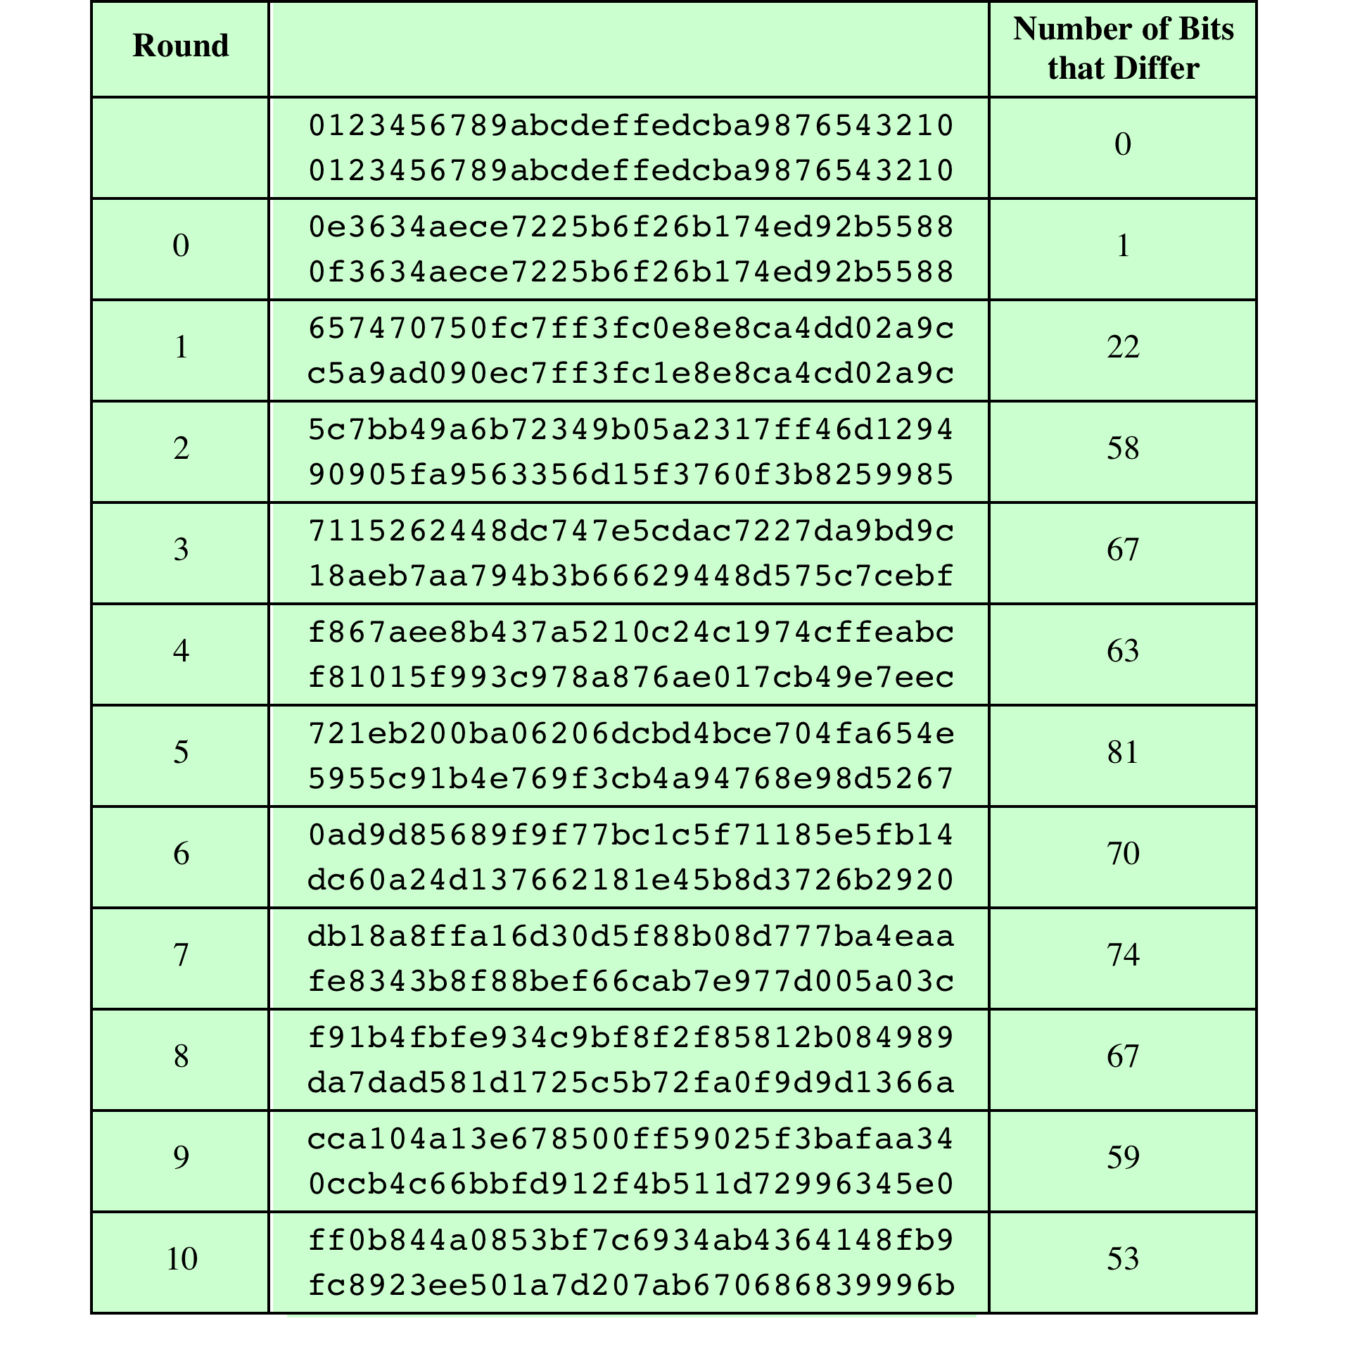
Table 6.7
Avalanche Effect in AES: Change in Key
Key: 0f1571c947d9e8590cb7add6af7f6798
0e1571c947d9e8590cb7add6af7f6798
(Table is located on page 171
in textbook)
Notes:
Table 5.6 shows the change in State matrix values when the same plaintext is
used and the two keys differ in the eighth bit. That is, for the second case, the key is
0e1571c947d9e8590cb7add6af7f6798. Again, one round produces a significant
change, and the magnitude of change after all subsequent rounds is roughly half
the bits. Thus, based on this example, AES exhibits a very strong avalanche effect.
Note that this avalanche effect is stronger than that for DES (Table 3.2),
which requires three rounds to reach a point at which approximately half the bits
are changed, both for a bit change in the plaintext and a bit change in the key.

Slide 54
AES Decryption
AES decryption is not identical to encryption since steps done in reverse
but can define an equivalent inverse cipher with steps as for encryption
  but using inverses of each step
  with a different key schedule
works since result is unchanged when
  swap byte substitution & shift rows
  swap mix columns & add (tweaked) round key
CEG 260, Meilin Liu
Notes:
Zili Shao
The AES decryption cipher is not identical to the encryption cipher (Stallings Figure 5.1). The sequence of transformations for decryption differs from that for encryption, although the form of the key schedules for encryption and decryption is the same. This has the disadvantage that two separate software or firmware modules are needed for applications that require both encryption and decryption. There is, however, an equivalent version of the decryption algorithm that has the same structure as the encryption algorithm, with the same sequence of transformations as the encryption algorithm (with transformations replaced by their inverses). To achieve this equivalence,a change in key schedule is needed.
By constructing an equivalent inverse cipher with steps in same order as for encryption, we can derive a more efficient implementation. Clearly swapping the byte substitutions and shift rows has no effect, since work just on bytes. Swapping the mix columns and add round key steps requires the inverse mix columns step be applied to the round keys first – this makes the decryption key schedule a little more complex with this construction, but allows the use of same h/w or s/w for the data en/decrypt computation.

Slide 55
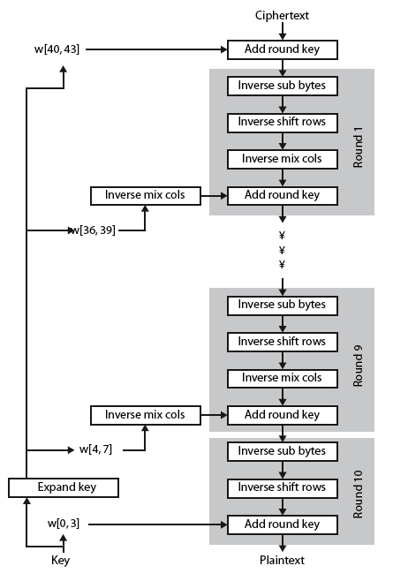
AES Decryption
CEG 260, Meilin Liu
Notes:
Zili Shao
Illustrate the equivalent inverse cipher with Stallings Figure 5.7.

Slide 56
Implementation Aspects
Can efficiently implement on 8-bit CPU
  byte substitution works on bytes using a table of 256 entries
  shift rows is simple byte shift
  add round key works on byte XOR’s
  mix columns requires matrix multiply in GF(2⁸) which works on byte values, can be simplified to use table lookups & byte XOR’s
CEG 260, Meilin Liu
Notes:
Zili Shao
AES can be implemented very efficiently on an 8-bit processor.
AddRoundKey is a bytewise XOR operation.
ShiftRows is a simple byte shifting operation.
SubBytes operates at the byte level and only requires a lookup of a 256 byte table S.
MixColumns (matrix multiply) can be implemented as byte XOR’s & table lookups with a 2nd 256 byte table X2, using the formulae shown in Stallings equation 5.9.

Slide 57
Implementation Aspects
Can efficiently implement on 32-bit CPU
  redefine steps to use 32-bit words
  can precompute 4 tables of 256-words
  then each column in each round can be computed using 4 table lookups + 4 XORs
  at a cost of 4Kb to store tables
Designers believe this very efficient implementation was a key factor in its selection as the AES cipher
CEG 260, Meilin Liu
Notes:
Zili Shao
AES can also be very efficiently implemented on an 32-bit processor, by rewriting the stage transformation to use 4 table lookups & 4 XOR’s per column of state. These tables can be computed in advance using the formulae shown in the text, and need 4Kb to store.
The developers of Rijndael believe that this compact, efficient implementation was probably one of the most important factors in the selection of Rijndael for AES.

Slide 58
AES in hardware
AES instructions in Intel Westmere:
aesenc, aesenclast: do one round of AES
128-bit registers: xmm1=state, xmm2=round key
aesenc xmm1, xmm2 ; puts result in xmm1
aeskeygenassist: performs AES key expansion
Claim 14 x speed-up over OpenSSL on same hardware
Similar instructions on AMD Bulldozer
Notes:
To implement AES called aesenc 9 times and then call aesenclast.

Slide 59
Attacks
Exhaustive Key Search
Side channel attacks: Timing Attacks, Power Attacks
Timing Attacks:
  One in which information about the key or the plaintext is obtained by observing how long it takes a given implementation to perform decryptions on various ciphertexts
  Exploits the fact that an encryption or decryption algorithm often takes slightly different amounts of time on different inputs
  So far it appears unlikely that this technique will ever be successful against DES or more powerful symmetric ciphers such as triple DES and AES

